Slide 1



Crowdsourcing Metadata
Reliably Augmenting Documents By Collecting and Interpreting Amateur Contributions
Peter Organisciak
September 22, 2015
1
Notes:
Good morning. Thank you for coming.
Particularly

Slide 2

Maximizing data quality
in using paid crowds for objective and
subjective encoding tasks

Slide 3
INTRODUCTION
Crowdsourcing



Commons-Based Peer Production

Human Computation
Free/Open Source
Human work organized in the manner and tropes of computation
Creation from the commons, stemming from increased agency in networked information economy.
Crowdsourcing
Lemon drops oat cake oat cake sugar plum
Broadly describes the use of distributed crowds to complete a task that would otherwise be done by one or a few people.
Captures the ability of the Internet toefficiently connect people

Lemon drops oat cake oat cake sugar plum sweet
Chocolate cake sweet pastry candy canes chocolate cake
Cake lollipop sweet

User Innovation
Wisdom of the Crowds
Lemon drops oat cake oat cake sugar plum sweet gingerbread cake.
observes the collected effectiveness of crowds when properly aggregated
2008
2011
von Ahn 2004
Surowiecki 2004
Benkler 2006
Howe 2006
3
Notes:
If the wisdom of the crowds refers to the unique abilities of human intelligence in aggregate, human computation focuses on human abilities as distinct from computational methods -- for so long as they are distinct -- and aims to formalize methods to organize humans in manners akin to automation.

Slide 4
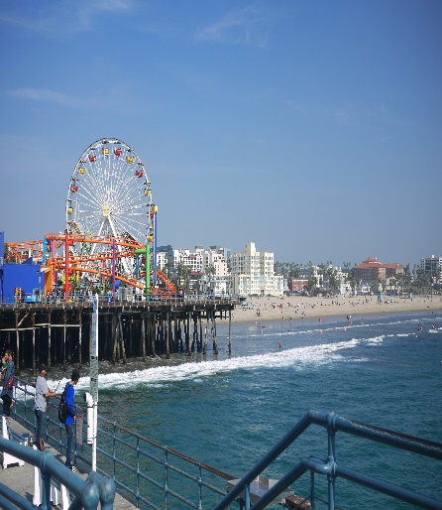
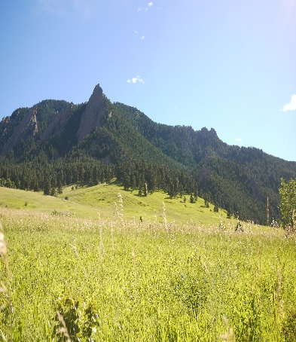
INTRODUCTION
Information Science
Image Tagging
Content Recommendation
e.g. steve.museum, The Commons
Lemon drops oat cake oat cake sugar plum sweet cake oreo


Relevance Judgments (IR Evaluation)

Lemon drops oat cake oat cake sugar plum sweet cake oreo



Transcription
e.g. Transcribe Bentham, Trove, What’s on the Menu
Research
Other Encoding
The Commons
Galaxy Zoo, Snapshot Serengeti
4

Slide 11
INTRODUCTION
Typical Task



11

Slide 12
INTRODUCTION
Typical Task









12

Slide 14
SECTION ONE
Creative Visual Design
Basic
Business
Professional
Expert




Liquorice chupa chups applicake apple pie cupcake brownie bear claw gingerbread cotton candy. Bear claw croissant apple pie. Croissant cake tart liquorice tart pastry cake
Liquorice chupa chups applicake apple pie cupcake brownie bear claw gingerbread cotton candy. Bear claw croissant apple pie. Croissant cake tart liquorice tart pastry cake
Liquorice chupa chups applicake apple pie cupcake brownie bear claw gingerbread cotton candy. Bear claw croissant apple pie. Croissant cake tart liquorice tart pastry cake
Liquorice chupa chups applicake apple pie cupcake brownie bear claw gingerbread cotton candy. Bear claw croissant apple pie. Croissant cake tart liquorice tart pastry cake
VIEW DETAILS
VIEW DETAILS
VIEW DETAILS
VIEW DETAILS
14

Slide 38
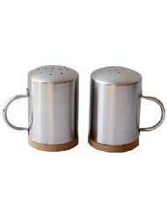
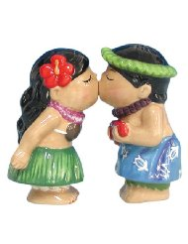
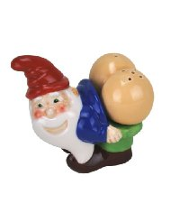
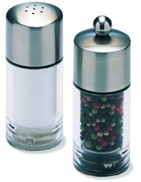
Notes:
I have a question.
Say you’re looking for a new set of salt and pepper shakers for your home Do you….
<click>… go for the charming kitsch of the kissing figures?
<click>Choose sleek option B?
<click>Perhaps you prefer the gift shop novelty of C or <click>the hominess of D?
(Ask audience for opinion)

Slide 39
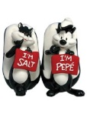
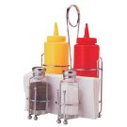
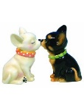
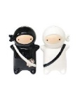
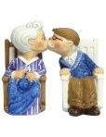
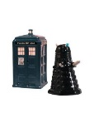
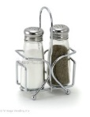
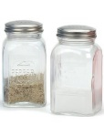
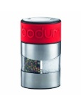
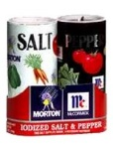
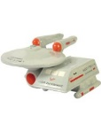
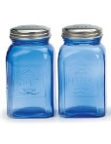
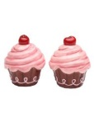
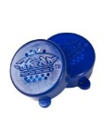
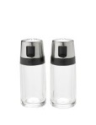
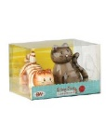
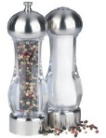
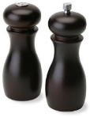
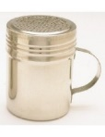
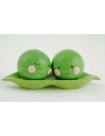
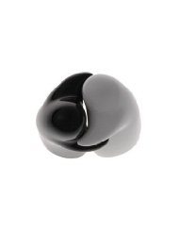
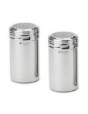
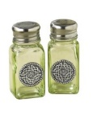
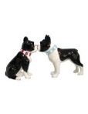
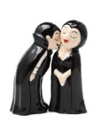
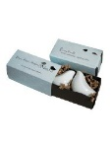
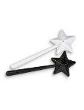
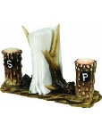
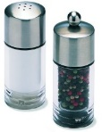
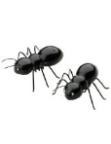
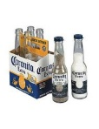
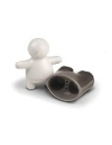
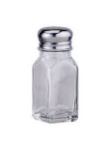
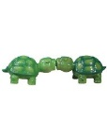
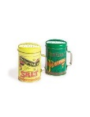
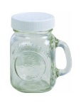
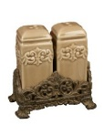
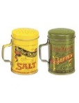
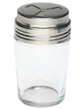
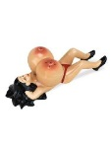

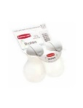
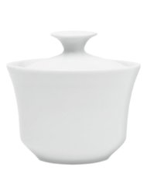
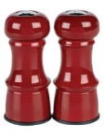
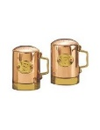














































Notes:
Okay, realistically we know that the space of salt and pepper shakers is much large than four.
that perfect item may be out there, but it doesn’t seem like something worth sinking too much of your time into.
Today we tackle this problem, of things you may not want to do, but that depend on your opinion that you have.
We do so, of course, through crowdsourcing.

Slide 40
















































































Notes:
In a case like this salt shaker example, you can use crowds to reduce your space considerably.
If you like the kissing Hawaiian, there’s many more similarly cute product (including a whole subgenre of kissing dogs)
If you like the gnome, there only two others for you, neither of which should be would be appropriate in this forum…

Slide 41













Notes:
How about other cases, like finding the food you’re craving ….

Slide 42

Notes:
Or filtering out the best photos from your vacation?

Slide 43
Good for…
Personal collections
New corpora
Niche information
Time-dependent preferences
Notes:
Why would you want on-demand personalization?
Good for collections with little existing data
Personal collections
E.g. personal photos, email
New corpora of data
E.g. the next Amazon, Netflix
Niche information
Where nobody would care enough to collect such preference data, nor would people care to volunteer it
Time-dependent opinions
When things change (e.g. food cravings, film desires), it’s difficult to collect information over an extended period of time

Slide 44
Research Question
How can crowdsourcing be applied to subjective data?
Approach
Introduce two approaches to personalized crowdsourcing – taste-matching and taste-grokking
Evaluate them against multiple tasks and task types
Scope
Paid crowdsourcing via Mechanical Turk
Notes:
Goal
To evaluate the feasibility of personalization through crowdsourcing
Also measure the crowd effort and return relationship
Focus on paid crowds, not as a rule, but because the question of motivation is tricky and confounding: we want to know if it works, then we can work on how to motivate users

Slide 45
†
‡
We show that crowdsourcing is useful for personalization
† Spoiler alert
‡ with nuances – this is where we help!
Notes:
…
3. We show that crowdsourcing can be useful for personalization.
First of all:
<click>
Sorry for giving away the ending, but also, the fun lies….
<click>
… in the nuances.
We evaluate numerous contexts over various data
Giving us an impressive of what is appropriate, when

Slide 46
Taste-matching
Requester
$$sim(requester, worker)$$
Crowd Worker
Notes:
How do our approaches work? In the first…
Taste-matching
Things to note
Finding your taste-soul mate; building your turker army
Similar to on-demand collaborative filtering
You can borrow techniques from there, e.g. sim measures
Where it can change
Similarity metric
Choice of training items
Size of training set
Not worth mentioning in talk: (Recommendation method: do you take a single similar worker’s suggestion, or an aggregate)

Slide 47
Taste-Grokking
Requester
Requester
Crowd Worker
Notes:
Taste-Grokking
Things to note:
No similarity measure
Showing by doing
Similar approach, but communicating by explanation, is utilized for travel-planning with Mobi (Zhang et al.) and

Slide 48




Requester
Requester
Requester
Requester
Notes:
Since multiple grokkers are thinking of the same person, grokking lends itself easily to aggregation

Slide 49

Notes:
Like the proverbial blind men beholding an elephant, each grokker has their own interpretation of the truth that is more effective in the bigger picture.
(No known copyright, http://www.loc.gov/pictures/item/2004666374/)

Slide 50














Task 1: Image Recommendation
Products
?
?
?
?
Food
?
?
?
?
Notes:
We applied these two protocols, taste-matching and taste-grokking, to two different types of tasks
Size of set used for profiling: 10 items; size of recommendation set:90
Image Recommendation
Product recommendation
Specifically, saltshakers
A highly visual decision, not common to find people rating multiple saltshakers in existing data
Food
Photo and name given
Two datasets provided, via Foodspotting: Seattle and Boston.
Quality of photo controlled for, somewhat, by sampling only most popular photos.
These are photos of food that are already liked, we want to differentiate by people

Slide 51
Results
Taste-Matching
Measured using root-mean-squared-error, to measure deviation of recommendation from ground truth of requester preferences
 | Products | Food Set #1 | Food Set #2
Baseline | 1.64 | 1.51 | 1.58
Best matched of five-workers | 1.43 (13%) | 1.19 (22%) | 1.26 (20%)
Best matched of ten workers | 1.35 (18%) | 1.08 (29%) | 1.08 (31%)
Notes:
The quality of the workers you find depends on how man you ask.
If you take the word of 1 person (the baseline)…
If you match against five people and use the opinion of the best…
Match against 10 people…
I’ll discuss this further later, but note that
Improvements on both sides, but
<click>
Food data was better improved by matching than product data
(why not aggregate taste-matching? This is possible; we were thinking of cases where you can accumulate ‘assistants’ that would look at different parts of the dataset for you)

Slide 52
Results
Taste-Grokking
 | Products | Food Set #1 | Food Set #2
Baseline | 1.64 | 1.51 | 1.58
Any grokker | 1.29 (21%) | 1.53 (1.3%) | 1.57 (0.5%)
5 rand grokkers | 1.07 (34%) | 1.38(9%) | 1.28 (19%)
5 good grokkers | 1.02 (34%) | 1.22 (19%) | 1.13 (28%)
Notes:
We found the inverse to be true for taste-grokking.
For taste-grokking, the salt-shakers are predicted much better.
For the food, if you ask anybody to guess, they’re not going to be that good; asking a few peope improves that recommendation.

Slide 53


Results
Personalization in this form was a good fit for crowdsourcing
Matching was better for food, grokking better for salt-shakers
Latent vs. Manifest decision factors: overfitting mental models
Increases in N are more fruitful for matching
Notes:
Matching was better for food, grokking better for salt-shakers
Why?
The factors of saltshaker decision making is more visible
When we tried clustering by taste, we saw more surprised in how food groups: overfitting mental models
In a complex space like food, you may need more profiling examples
If you can afford it, added people to matching keeps improving quality
In grokking, you only need a few people

Slide 54
Super-grokkers
The best grokkers outperform the best-matched
 | Products | Food | Food
Baseline | 1.64 | 1.51 | 1.58
Taste-matching: Best 3 workers | 0.89 (46%) | 1.02 (32%) | 1.19 (25%)
Taste-grokking: Best 3 workers | 0.87 (47%) | 0.78 (48%) | 0.79 (50%)
Notes:
- The trick is identifying them beforehand, which is difficult to do

Slide 55
























Requester
Requester
Crowd Worker
Notes:
In all these experiments, we randomized the training examples, but it should be noted that the training data matters.
When we purposively chose profiling information to maximize breadth…

Slide 56

Notes:
We saw a clear improvement in grokking ability.

Slide 57

Task 2: Text Summarization
Film Reviews
Notes:
Recommendation is a fairly straightforward task. Can we personalize on much more complex tasks?
To this end, we looked at the ability of crowd workers to highlight film reviews for summarization. They would try to mimic both the salient content, and the amount of highlighted.
- difficult to measure, we used text overlap via F1 measure (the harmonic mean btw precision and recall)
Training example N=1 (based on expected information communicated)

Slide 58
Matching does work for a complex task like this
Grokkers fare poorly, but once again, we see super-grokkers
Potentially an appropriate task for written expression of needs, a la EmailValet (Kokkalis et al. 2013) and Mobi (Zhang et al 2012)
 |  | Performance ($F_{1}$)
Baseline |  | 0.32
Taste-matching | Best-matched workers | 0.39 (20%)
 | 5 best-matched workers | 0.38 (17%)
Taste-grokking | Any worker | 0.30 (7%)
 | Best workers (pool of 5) | 0.52 (62%)
Notes:
Film highlighting
Surprisingly, matching does work for a complex task like this

Slide 59
Matching or Grokking
Data Re-use
Grokking is requester-specific; matching is useful for bootstrapping collaborative filtering and has higher ceiling.
Quality Control
Grokking is task-driven, with apparent ground truth – traditional quality control can be used.
Task Complexity
Are the factors affecting opinion-forming easy to communicate by example?
Satisfaction
Feedback suggests grokking seems more fun
Notes:
Grokking is task-driven, with apparent ground truth – traditional quality control can be used.
In matching, workers are asked to give their opinion, so it’s hard to tell if they are cheating; however, they’ll usually remain unmatched
Task complexity
Are the factors affecting opinion-forming easy to make sense of?
- Our workers spoke of their decision making for salt-shakers in predominantly visual terms

Slide 60
Takeaway
Crowdsourcing doesn’t have to be only objective or normative tasks! It is promising in domains where lack of prior data limits established personalization methods.
Taste-matching is good for personalizing complex tasks, and ongoing engagements with workers
Taste-grokking is great for quick-start tasks with manifest opinion factors, and for spicing up boring tasks

